Slide 1
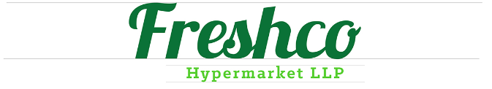

Freshco hypermarket capstone
By-Swadha Singh

Slide 2
TOPICS
ORDER LEVEL ANALYSIS
COMPLETION RATE ANALYSIS
CUSTOMER LEVEL ANALYSIS
DELIVERY ANALYSIS

Slide 3
ORDER LEVEL ANALYSIS
Order Distribution at slot & Order drop Geo Level Analysis.
Afternoon-Highest order distribution.
Morning & Night- Substantial Night.
Late Night- Lowest Order.
Optimize resources based on active time slot.
HSR Layout,ITI Layout,Harlur-Highest Order.
Binnipet,Pattandur,Brookefield,Frazer Town-Lowest Order.

Slide 4
Delivery charges as a percentage of product amount at slot and month level
Delivery fees have decreased from January to September.
Possible reasons include policy changes, promotions, customer behavior, and regional differences.
Identify and implement strategies that proved successful in previous months to maintain or improve performance.
Optimize Late-Night Delivery Fees: Consider reducing delivery charges during late-night hours to encourage more order.
Implement Time-Based Pricing: Adjust delivery fees based on the time of day to incentivize orders during less busy periods.
Promote Off-Peak Ordering: Offer promotions or discounts to customers who place orders during lower-charge time slots.

Slide 5
Discount as a percentage of product amount at Order Drop Geo Level Analysis.
Focus on High-Discount Areas: Offer targeted discounts in Harlur, Bilekahalli, and Bellandur.
Optimize Discounts: Tailor discount offers to specific areas to maximize effectiveness.
Increase Sales: Strategically boost order volumes in these regions.

Slide 6
Key Insights and Recommendations
Comprehensive Data Analysis: Thoroughly analyzed order patterns, charges, and discounts to gain a deep understanding of customer behavior and business performance.
Customer-Centric Approach: Developed data-driven strategies to enhance customer satisfaction and loyalty.
Targeted Campaigns: Create more focused marketing campaigns based on customer data to reach the right audience.

Slide 7
COMPLETION RATE ANALYSIS Completion Rate at day of week and Slot level-
Sunday Success: Orders placed on Sundays have the highest completion rate at 15.43%.
Weekday Consistency: Monday to Thursday exhibit relatively consistent completion rates, ranging from 13.48% to 13.82%.
Weekend Trend: Completion rates increase from Thursday to Saturday, peaking at 14.89% on Saturday.
Afternoon Peak: The afternoon has the highest completion rate at 25.96%.
Late-Night Low: Late-night orders have the lowest completion rate at 6.96%.
Consistent Evening and Morning: Evening and morning orders have relatively consistent completion rates, ranging from 20.65% to 23.61%.

Slide 8
Completion Rate Analysis at no. of products ordered level.
Smaller Orders, Higher Completion: Orders with 1-5 products have the highest completion rate at 69.94%.
Decreasing Completion with Larger Orders: As the number of products ordered increases, completion rates generally decline.
Minimal Large Orders: Orders with 21-25 products are relatively rare, accounting for only 0.17% of total orders.

Slide 9
Key Insights and Recommendations
Understand Customer Behavior: We observed different ordering patterns on different days.
Tailor Marketing: Adjust marketing strategies based on the day of the week and focus on popular delivery areas.
Improve User Experience: Make it easier for customers to place larger orders.
Boost Engagement: Encourage more customers to use our service and complete their orders.

Slide 10
CUSTOMER LEVEL ANALYSIS Completion rate at source level
Organic Source: Organic channels have the highest completion rate at 29.29%, indicating strong organic reach and engagement.
Paid Channels Perform Well: Facebook, Google, and Offline Campaigns also show solid completion rates, suggesting effective paid advertising strategies.
Instagram and Snapchat Lag: Instagram and Snapchat have slightly lower completion rates compared to other channels.

Slide 11
Aggregated LTV at customer acquisition source & Month level.
Snapchat Success: Snapchat acquires customers with the highest LTV.
Strong Performance: Google and Offline Campaigns also generate high-value customers.
Lower LTV: Instagram & Organic channels comparatively lower LTV.
Customers acquired in "May" show highest aggregated LTV.
"Sep" & "Mar" have lowest aggregated LTV.
Marketing effectiveness might contribute to May's success.
Strategies for boosting LTV during low months could be explored.

Slide 12
Average Revenue per order at different customer acquisition Source & Month level.
Snapchat and Google Lead: Snapchat and Google have the highest average revenue per order.
Offline Campaigns Perform Well: Offline campaigns also generate significant revenue per order.
Instagram and Facebook Lag: Instagram and Facebook have lower average revenue per order compared to other channels.
May is Top Performer: May generated the highest average revenue per order.
September Lags: September had the lowest average revenue per order.
Boost Off-Peak Spending: Explore strategies to increase sales during slower months.

Slide 13
Key Insights and Recommendations
Snapchat Success: Snapchat is a top-performing platform for both customer lifetime value (LTV) and revenue per order.
May is Promising: Acquiring customers in May leads to higher LTV and spending.
Organic Potential: Organic sources have good completion rates but need strategies to increase spending.
Room for Improvement: Instagram and Facebook require improvements in acquisition and retention.
Boost Organic Spending: Develop strategies to encourage higher spending from organic customers.
Prioritize Snapchat: Continue investing in Snapchat to acquire high-value customers.

Slide 14
DELIVERY ANALYSIS. Average overall delivery time at Month level.
Fastest delivery months: February, September, July (around 19 minutes).
Slowest delivery months: April and May (around 27 and 44 minutes respectively).
Slight fluctuations observed across months.
Strategy: Study factors affecting delivery times during slower months.

Slide 15
Average Overall Delivery Time at Delivery Area and Month Level.
Fastest delivery areas: Bellandur Ecospace, Bellandur ETV.
Proximity, efficient routes, low congestion could contribute.
Slowest delivery areas: CV Raman Nagar, Pattandur, etc.
Distance, Traffic, and route efficiency could impact.
Fastest Months: February, September, and July have the quickest deliveries.
Slowest Month: May has slower deliveries. Analyze local conditions or demand.
Identify Reasons: Understand why delivery times vary across months.
Optimize Performance: Use successful strategies from faster months to improve overall delivery times.

Slide 16
Average overall delivery time at month and weekday/weekend level.
Weekend Delays: Deliveries take slightly longer on weekends.
Factors: Increased traffic and activities might contribute to slower deliveries.
Analyze Operations: Assess staffing, routes, and efficiency on weekends.
Improve Weekend Delivery: Optimize resources and processes for better weekend performance.

Slide 17
Key Insights and Recommendations.
Delivery Times Fluctuate: Delivery times vary by month, location, and time.
Factors Impact Delivery: Distance, traffic, routes, and demand affect delivery speed.
Improve Operations: Optimize routes, resources, and infrastructure.
Tailor Strategies: Adjust strategies based on specific area needs.

Slide 18
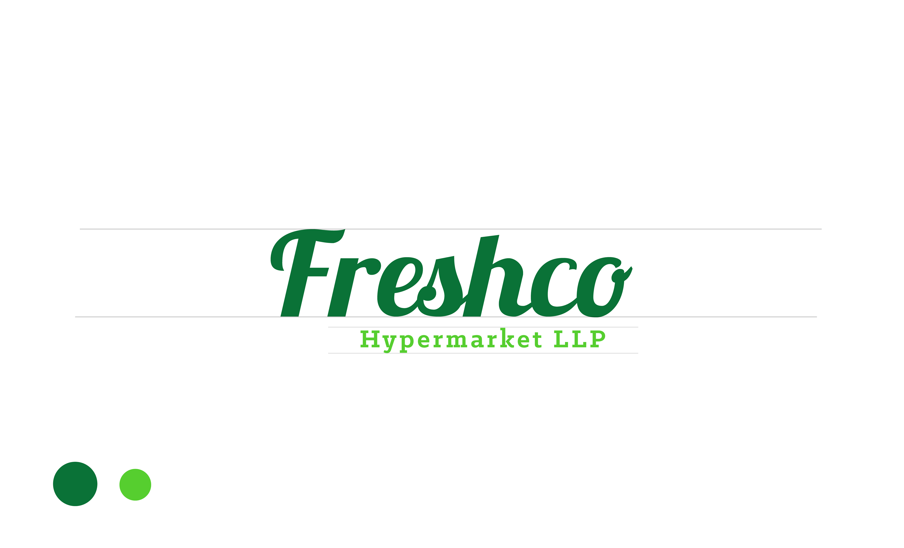
THANK YOU !!

